Slide 1
Agenda
1. Objectives of the Meeting (5 mins)
2. Quick overview of SasView functionalities for BioSAS (10 mins)
3. Discussion: What are we missing? (35 mins)
4. Next steps (10 mins)

Slide 2
Motivation
To define short- and long-term roadmaps that better support BioSAS users in SasView.

Slide 3
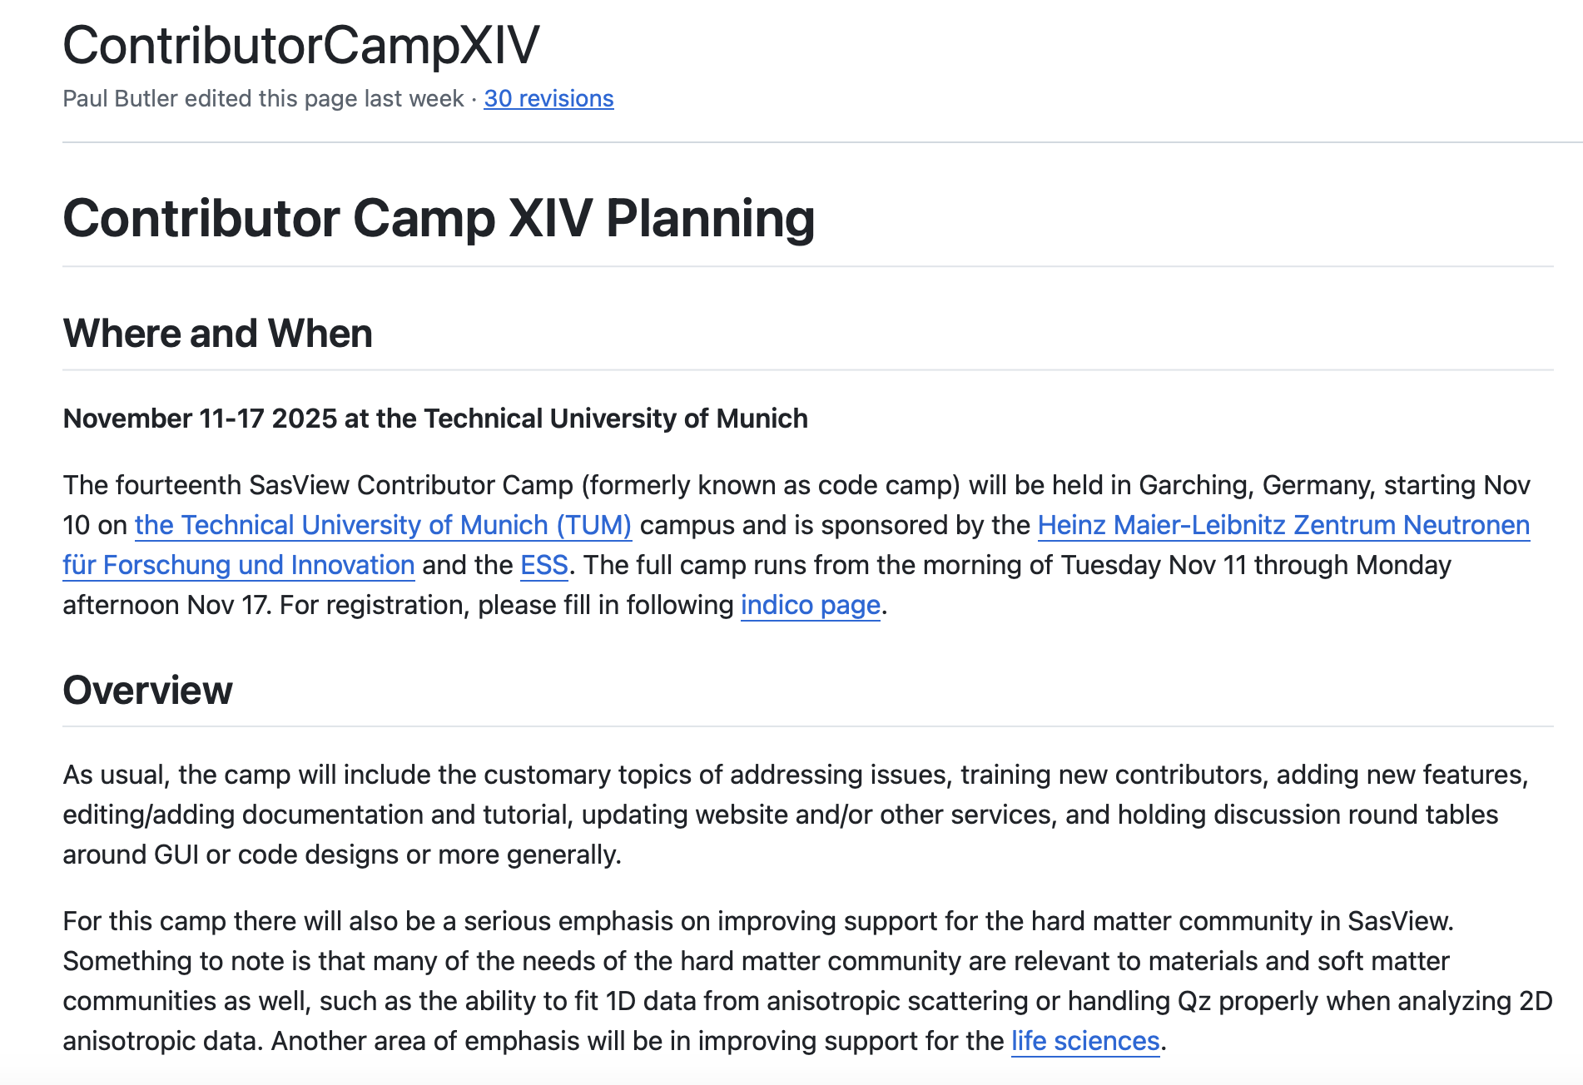

Slide 4

Small Angle Scattering Analysis Toolkit

Slide 5
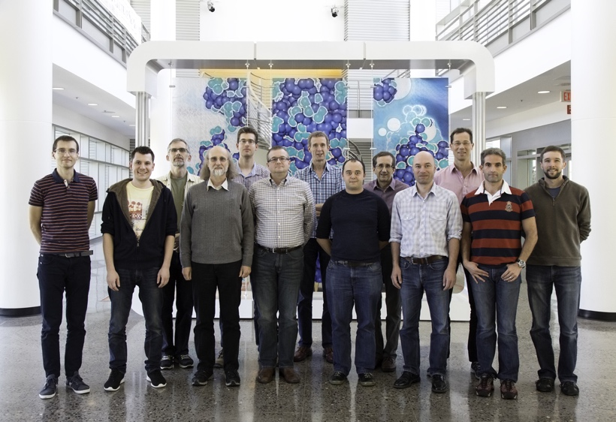
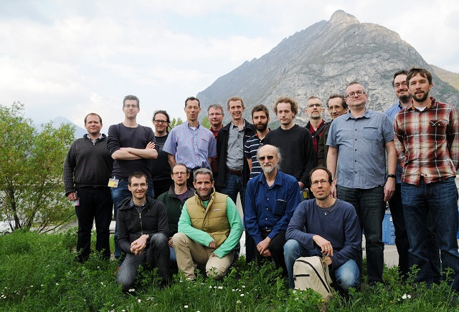
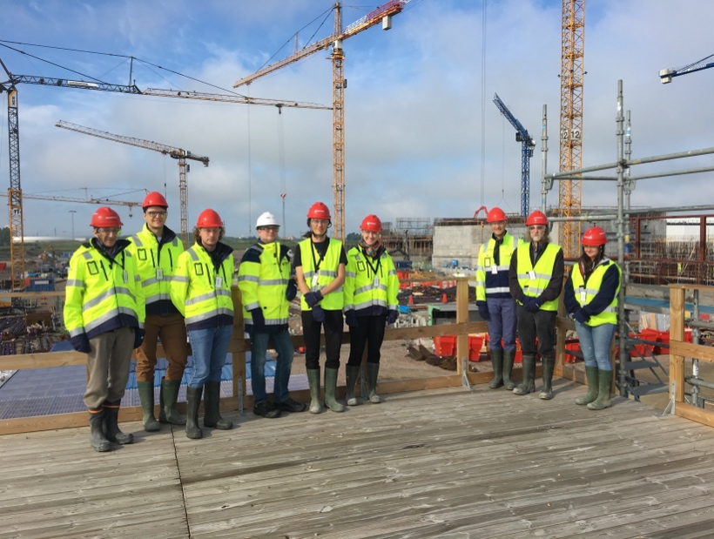
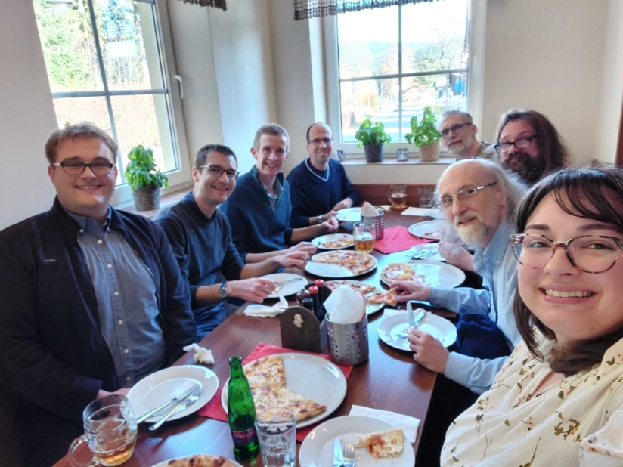
The SasView approach
An open, collaborative, community development
Community driven project
Supported by 10 facilities, 40 contributors (~15 active at any one time)
Small leadership team: Paul Butler (NIST), Jeff Krzywon (NIST), Steve King (ISIS), Wojciech Potrzebowski (SciLifeLab)
Biweekly calls
Regular SasView camps and hackathons
Hosted on github: https://github.com/SasView/sasview
Pictures from Code Camps: V, VI, VIII, X
www.sasview.org

Slide 6
SasView collaboration rules
Those who bring the resources (time, effort, funds) choose what to work on
but cannot break existing experiences ...

Slide 7
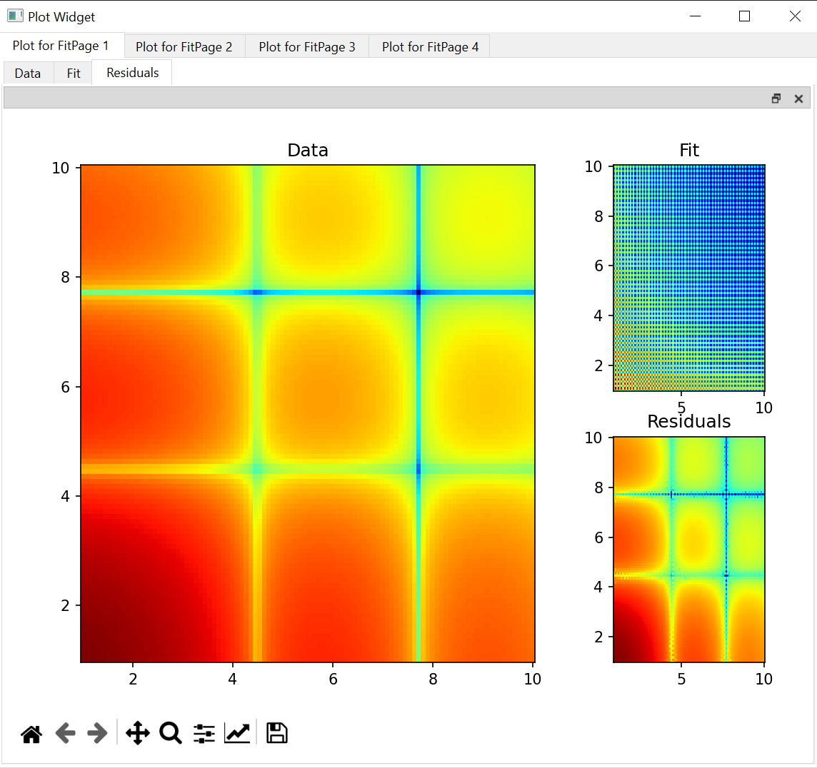
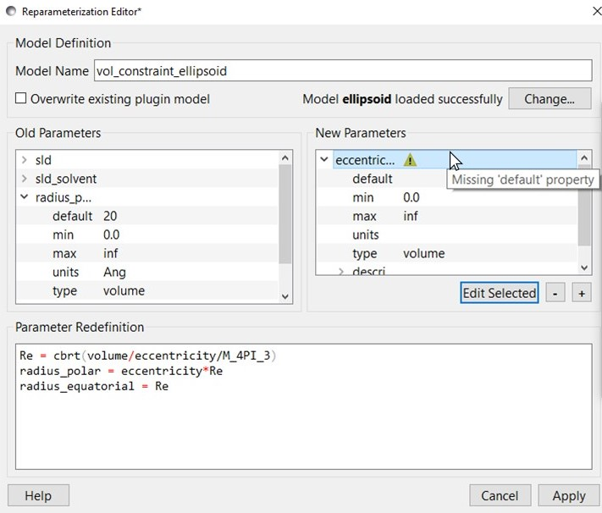
Contributed projects
Simultaneous SAXS and SANS fitting
Improvements in:
Plotting
Data structure (trends)
Documentation
Plugin Editor
Slicers
Generic Scattering Calculator
Web-based API
Pore size distributions
Shape2SAS
Project Database
Contributors: Iestyn Cadwallader-Jones, Nouhalia Agouzal, Dorian Lozano, Julius Karliczek (ILL), Ellis Hewis, James Crake-Merani, Ruben Lopes (ISIS), Alex Zheng (NIST), Brayden Miller (NIST), Xael Shan (NIST), Anita Zhang (Princeton), Kristian Lytje (Arhus University), Summer Hansen (SNS)

Slide 8
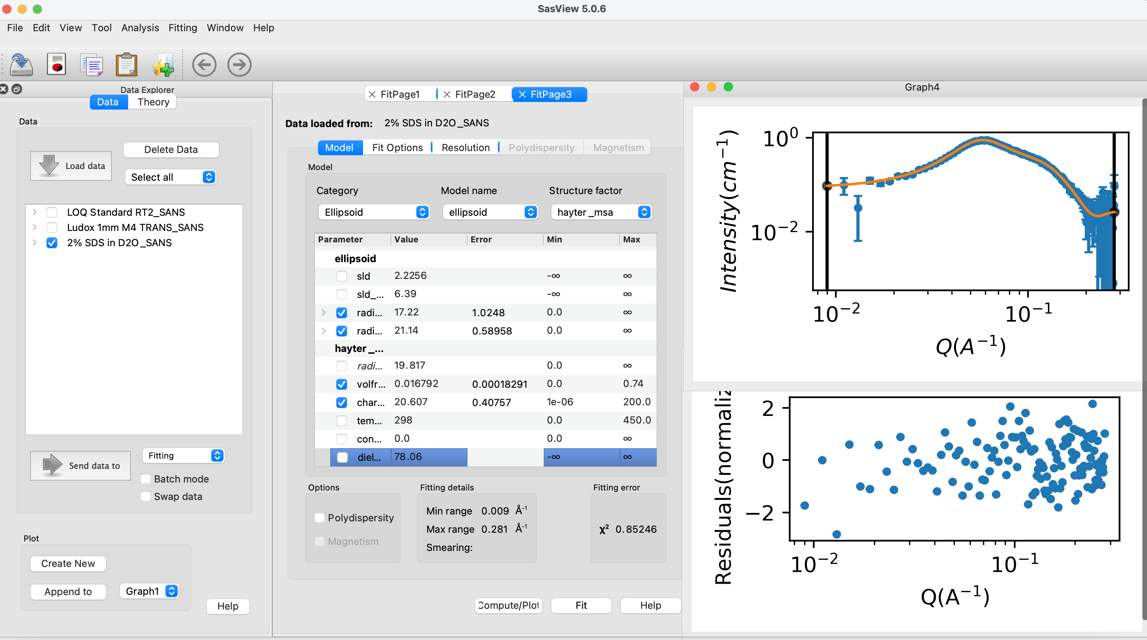
70+ models to explain data
Wide choice of built-in models (> 70)
F(Q), S(Q) & F(Q)*S(Q)
Single, batch and simultaneous 1D and 2D fitting
Data management
Common data formats supported, including NXCansas & cansas1D
Analysis Tool Choice
&
Plotting
Polydispersity (choice of distribution and distribution parameters)
Resolution smearing (pinhole and slit)
Automatically from data or provide parameters

Slide 9
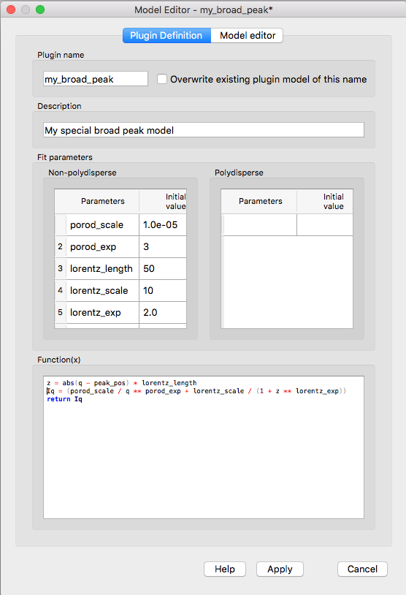
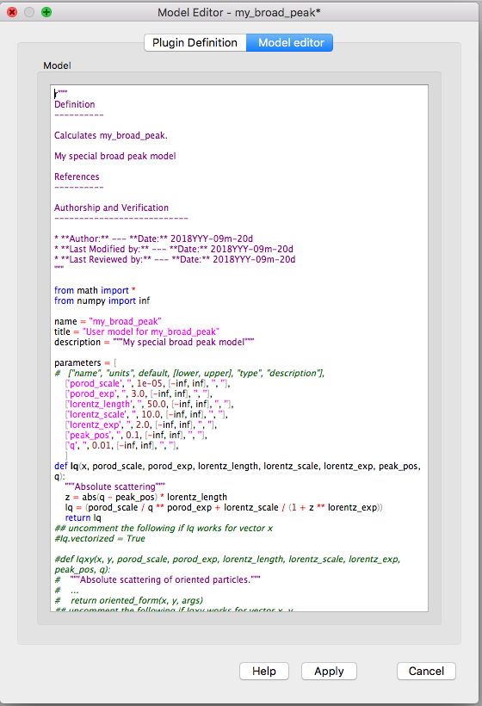
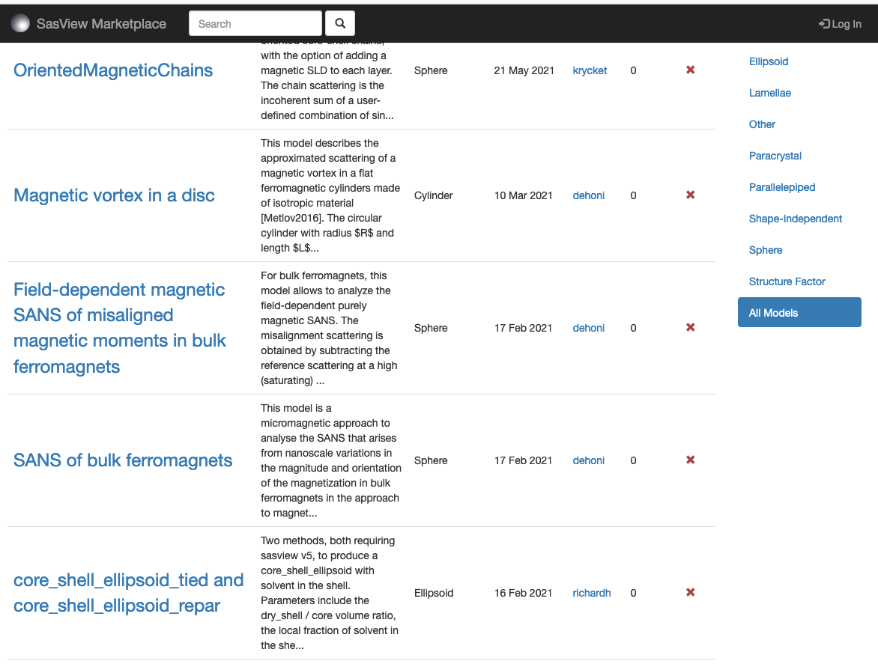
Plugin models
Dedicated editor
Syntax and performance testing
Directly available in SasView ecosystem
Community developed models can be deposited to marketplace: https://marketplace.sasview.org/

Slide 10
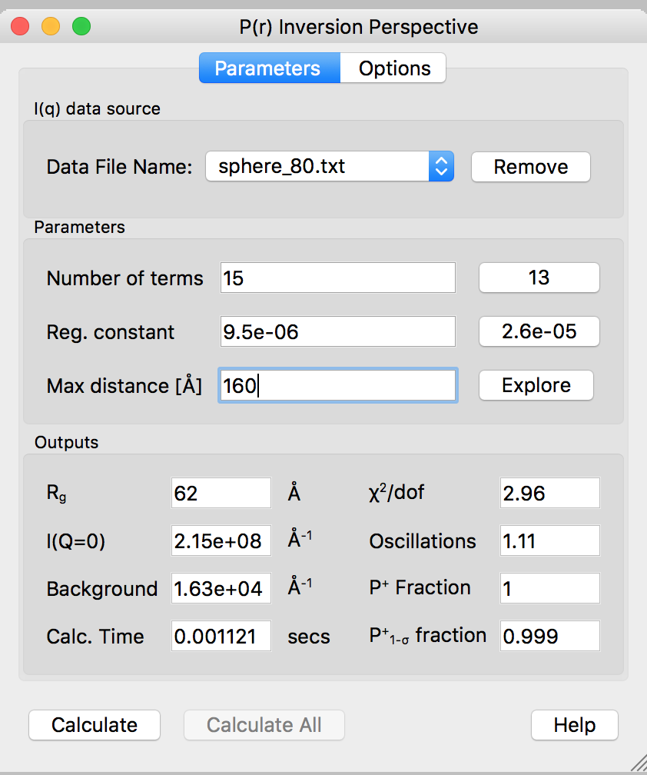
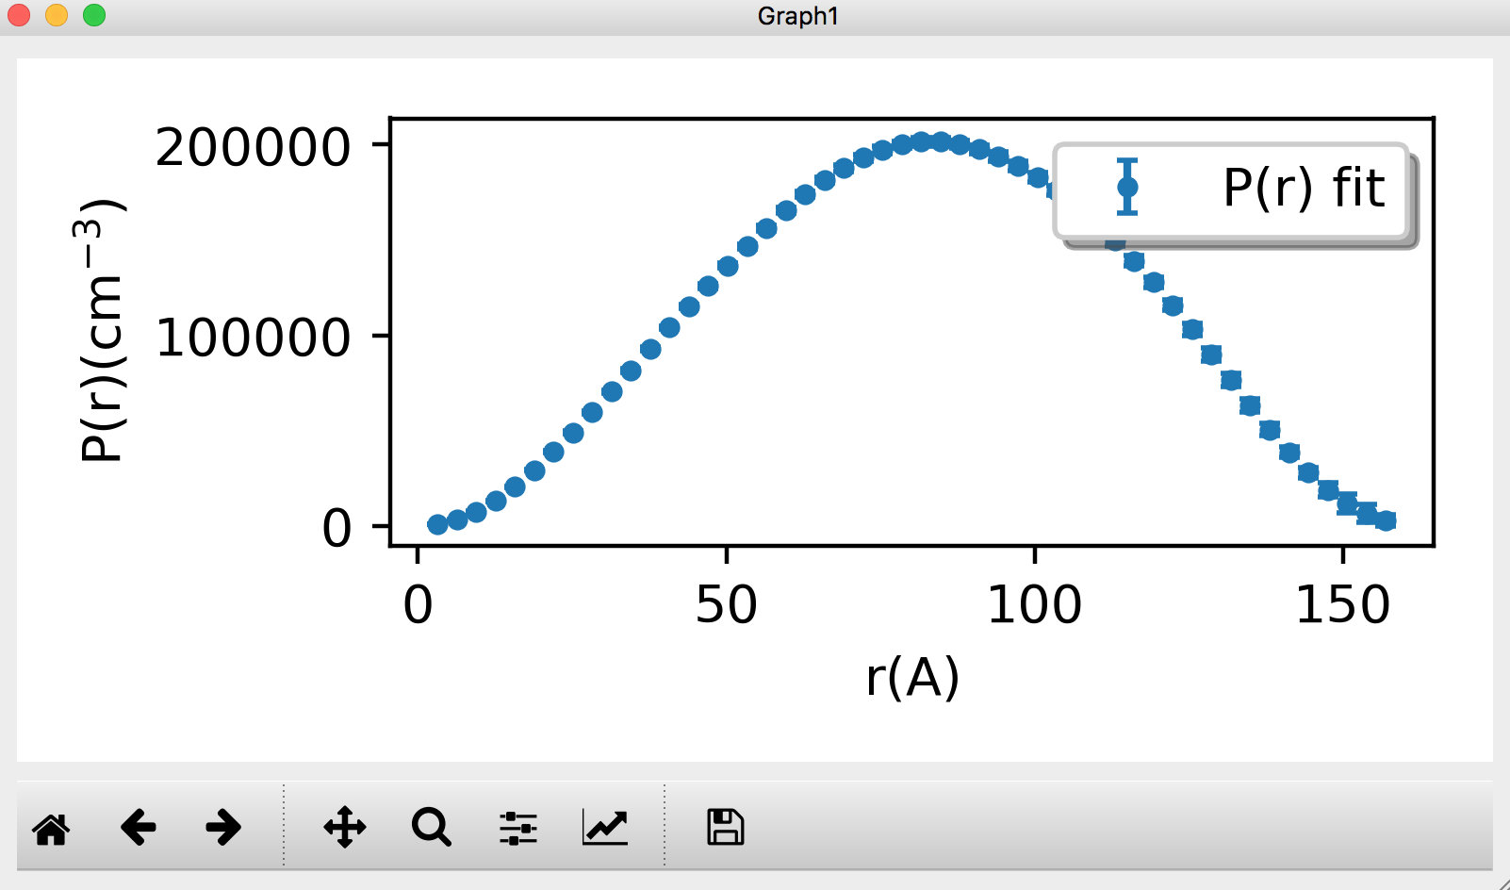
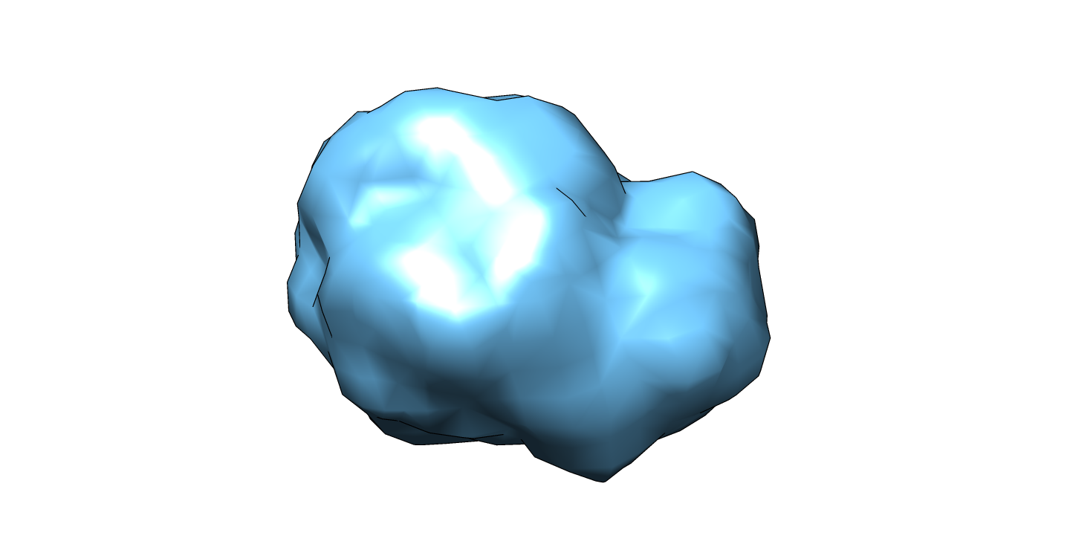
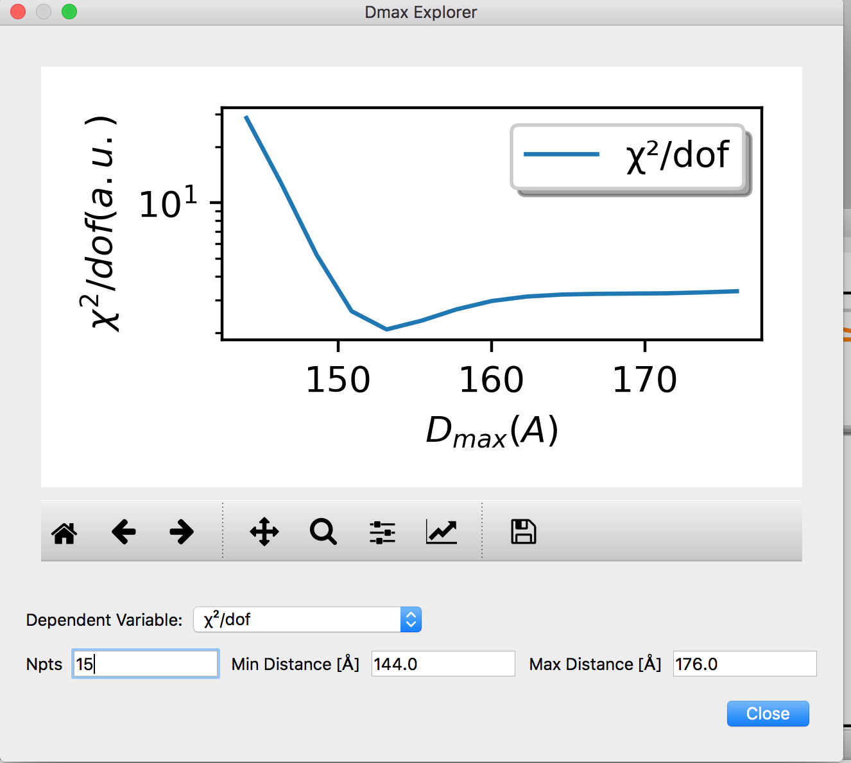
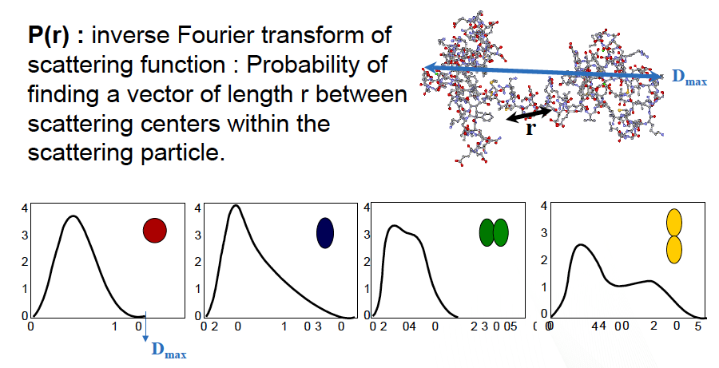
P(r) inversion using Moore’s derivation
D_{max}

Slide 11
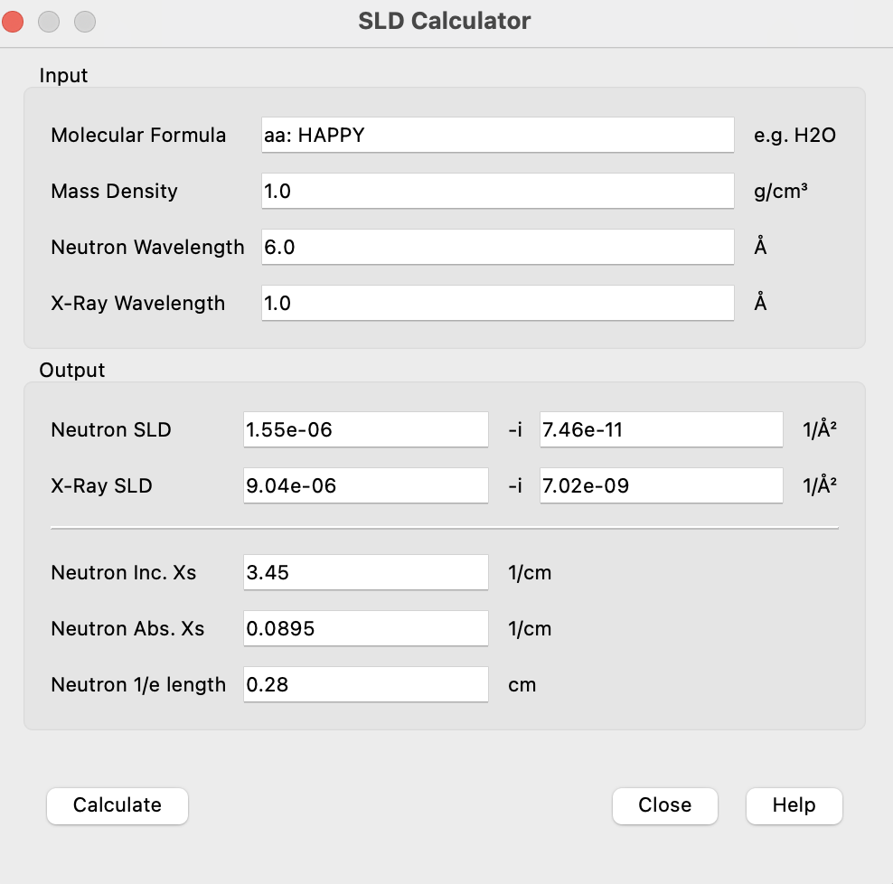
SLD calculator works for AA sequence

Slide 12
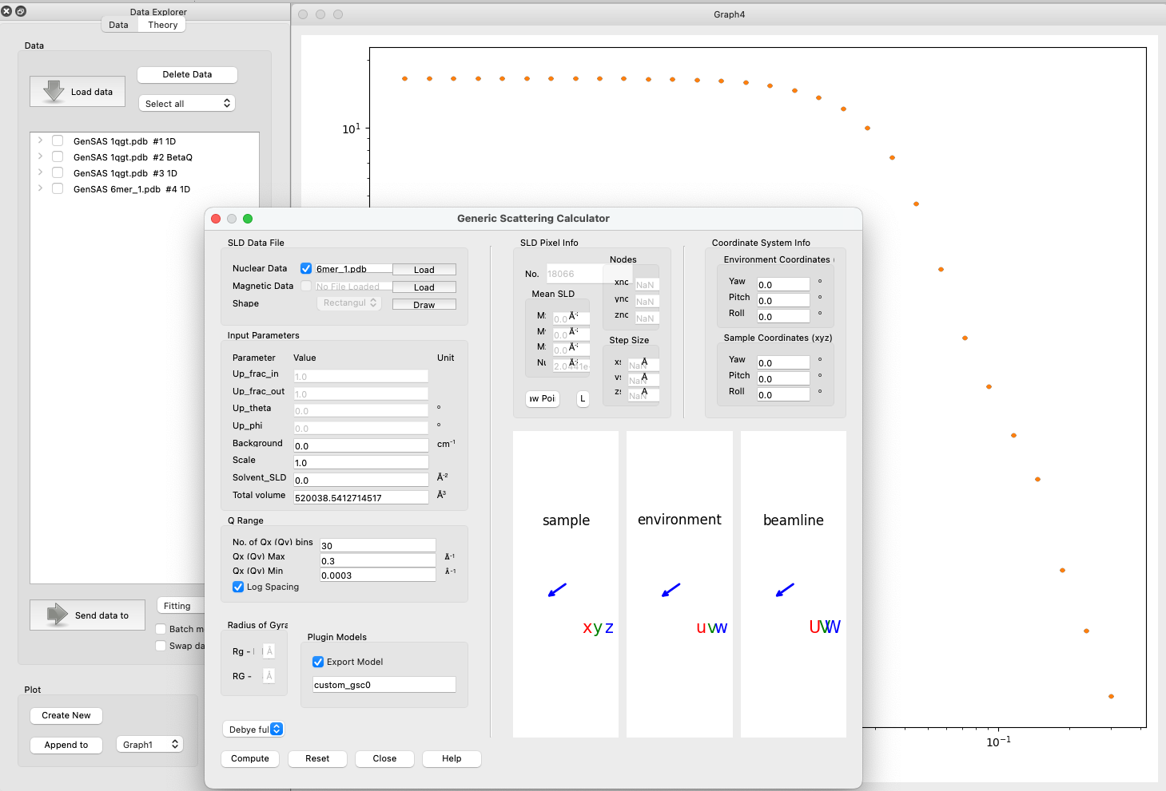
Generic Scattering calculator improvements
Interacting bio-molecules
Generate scattering profile from PDB file
Save as a custom/plugin model
Use for fitting with structure factors (including beta approximation)
PDB reader and engine refactored
Validation of electron-microscopy maps using solution small-angle X-ray scattering
Kristian Lytje and Jan Skov Pedersen, Volume 80| Part 7| July 2024| Pages 493-505

Slide 13
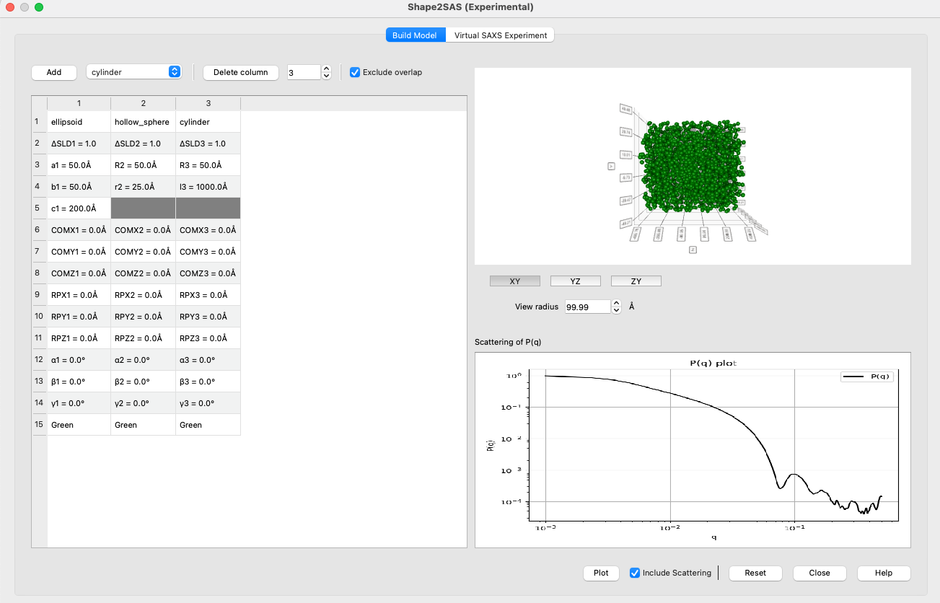
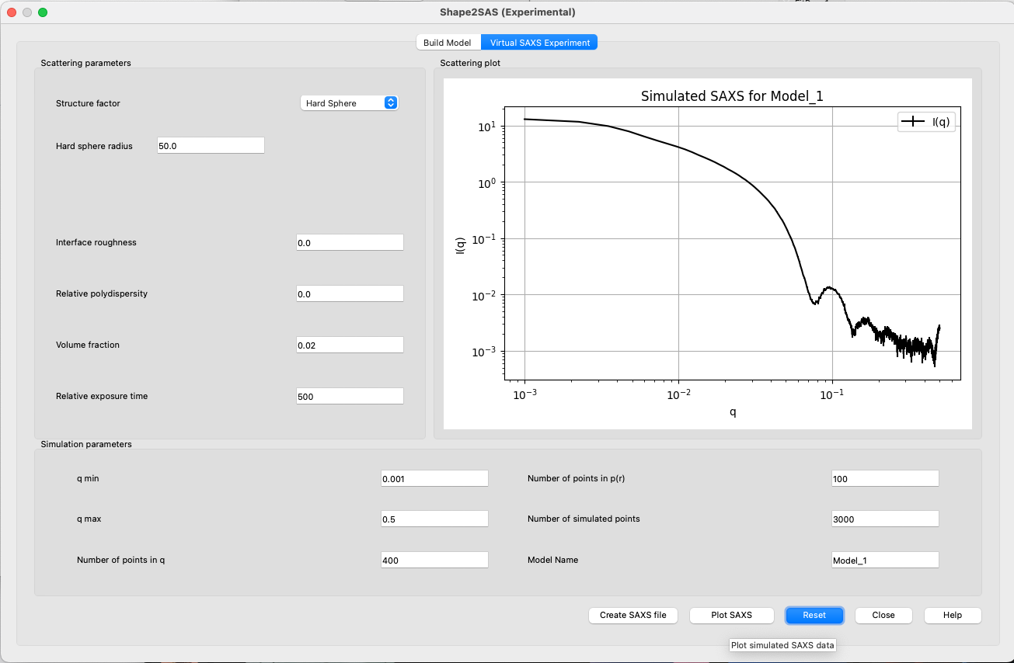
Shape2SAS
Shape visualization
Shape definition
Scattering profile
Structure
factor
Shape2SAS: a web application to simulate small-angle scattering data and pair distance distributions from user-defined shapes.
Andreas Haahr Larsen,^{a*} Emre Brookes,^{b} Martin Cramer Pedersen^{c} and Jacob Judas Kain Kirkensgaard^{c,d}
Profile saving

Slide 14
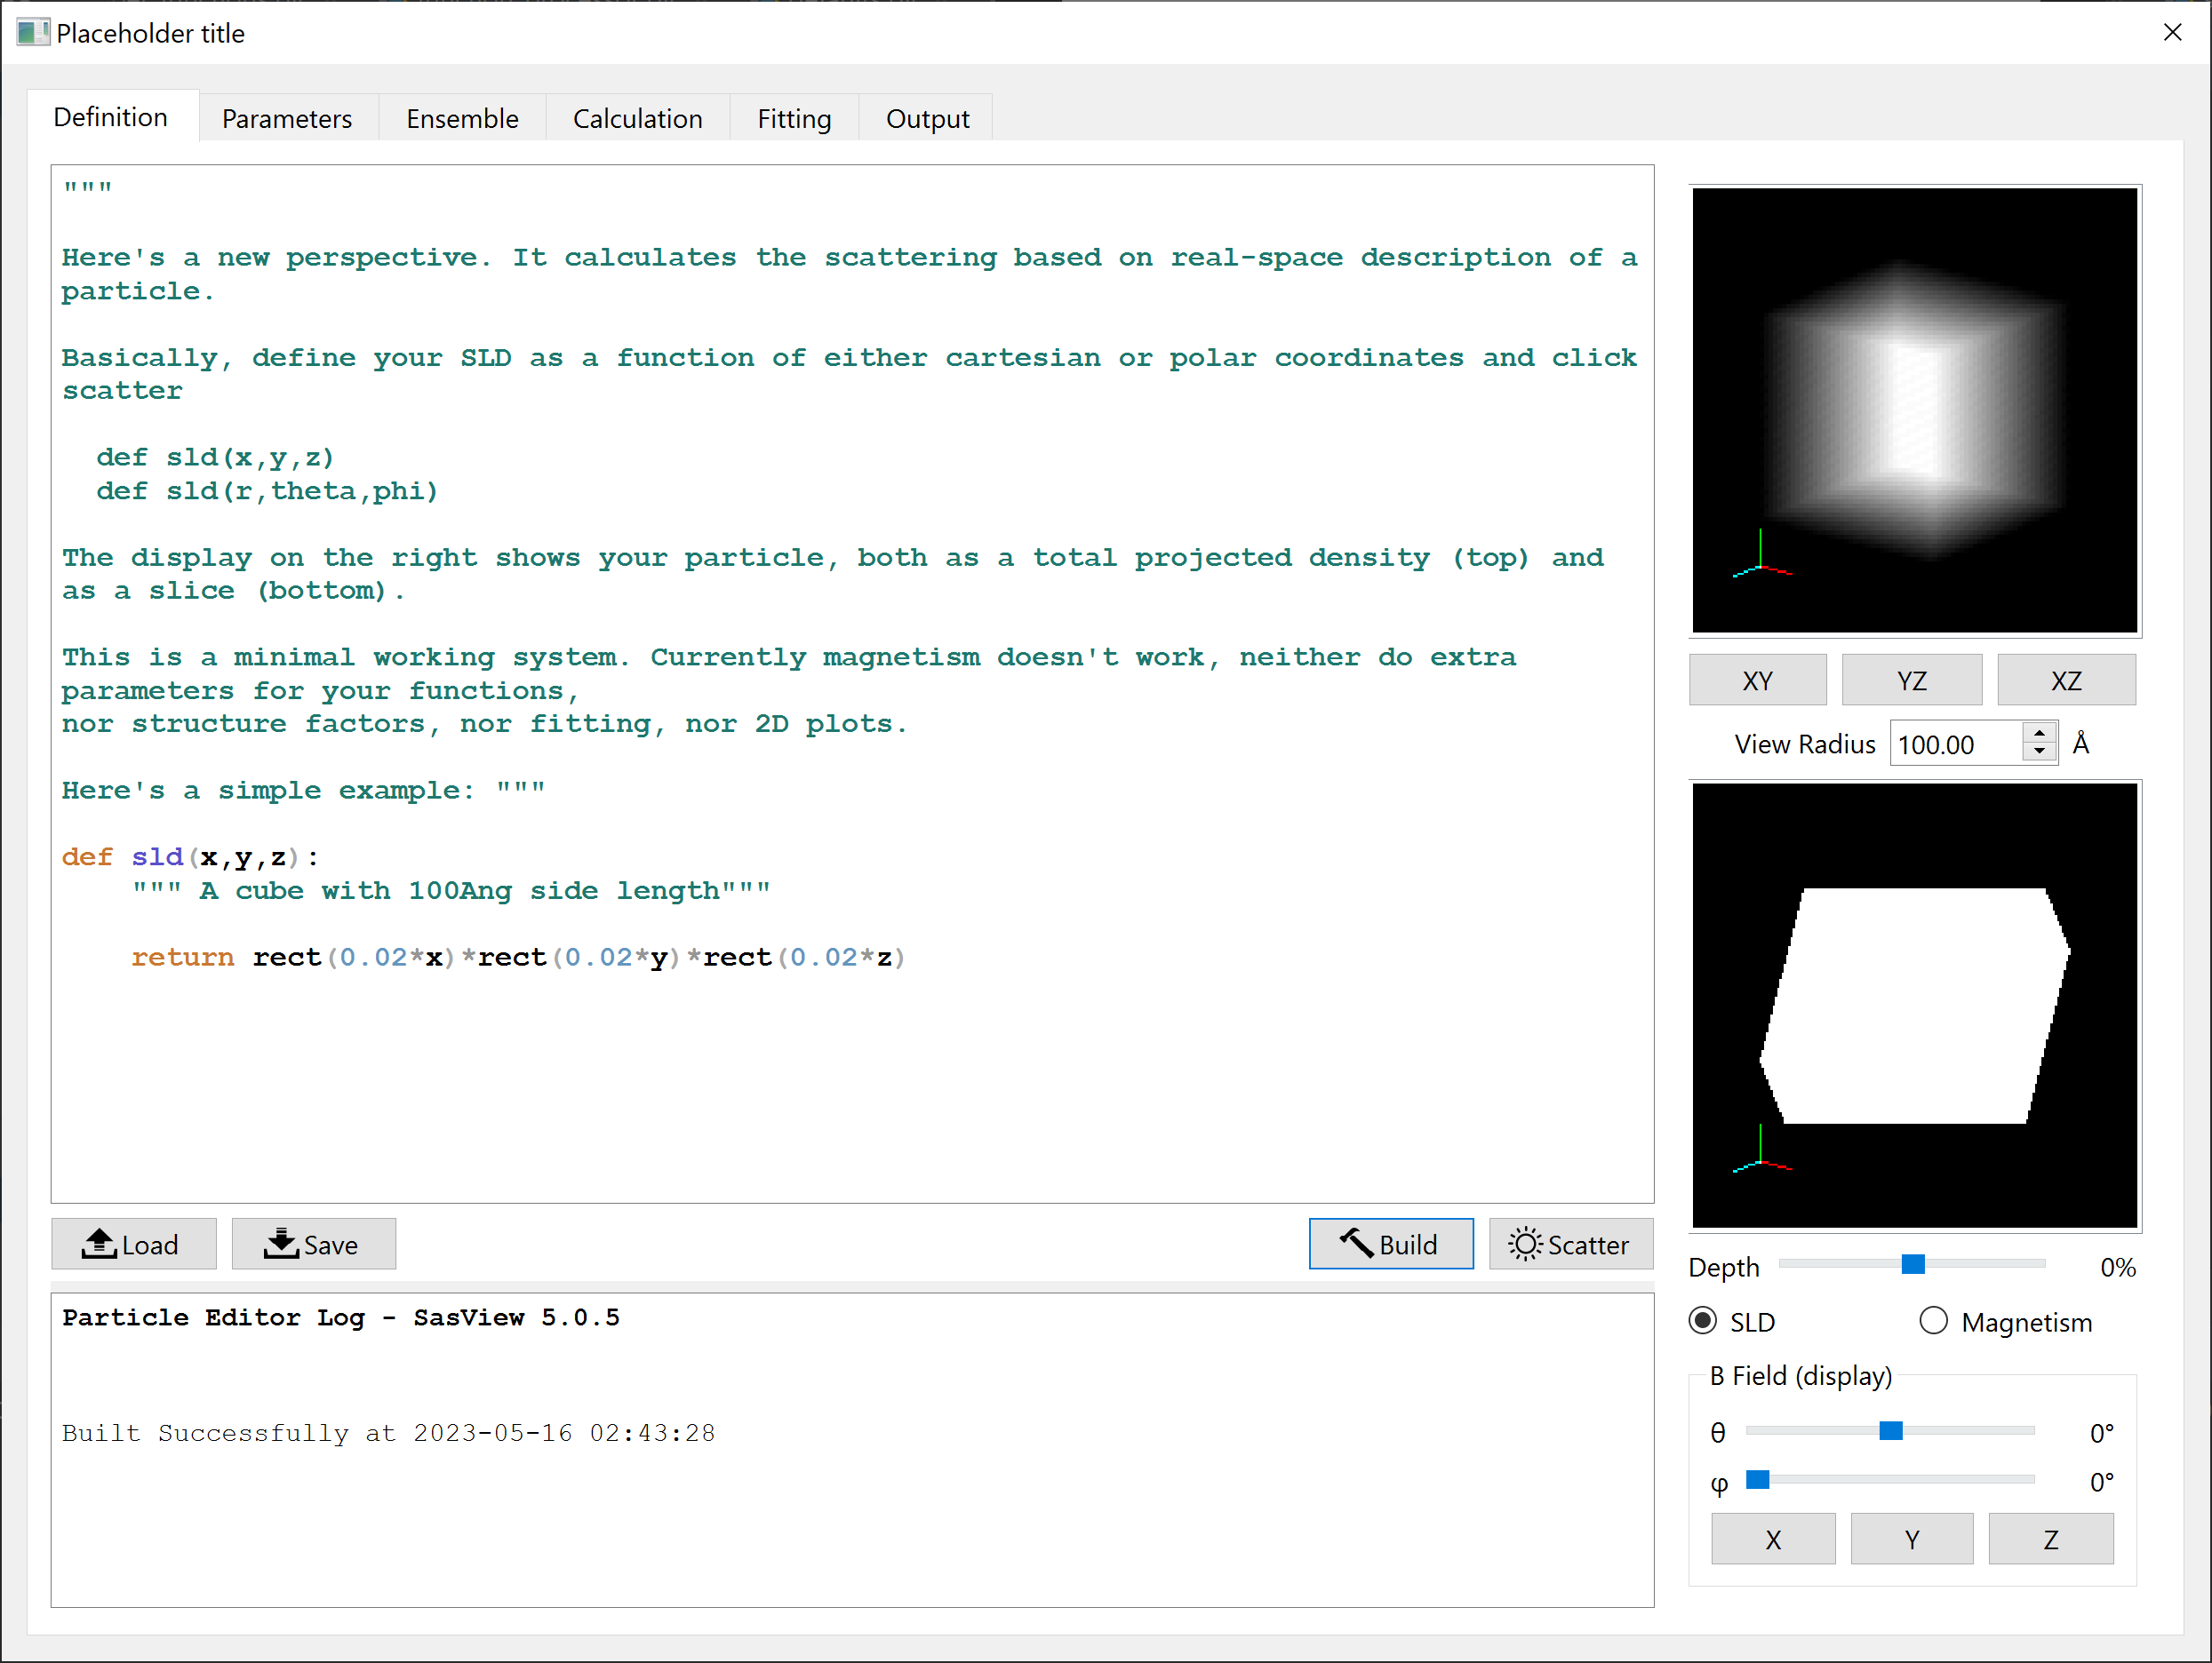
Particle Editor
Define functions
sld and (optionally)
magnetism
sld / magnetism
“x-ray” projection
sld / magnetism
cross section
Feedback on
code and calculations
Magnetic field
controls for display
“Recompile” and
update display
Compute
scattering
Lucas Willkins (ISIS)

Slide 15

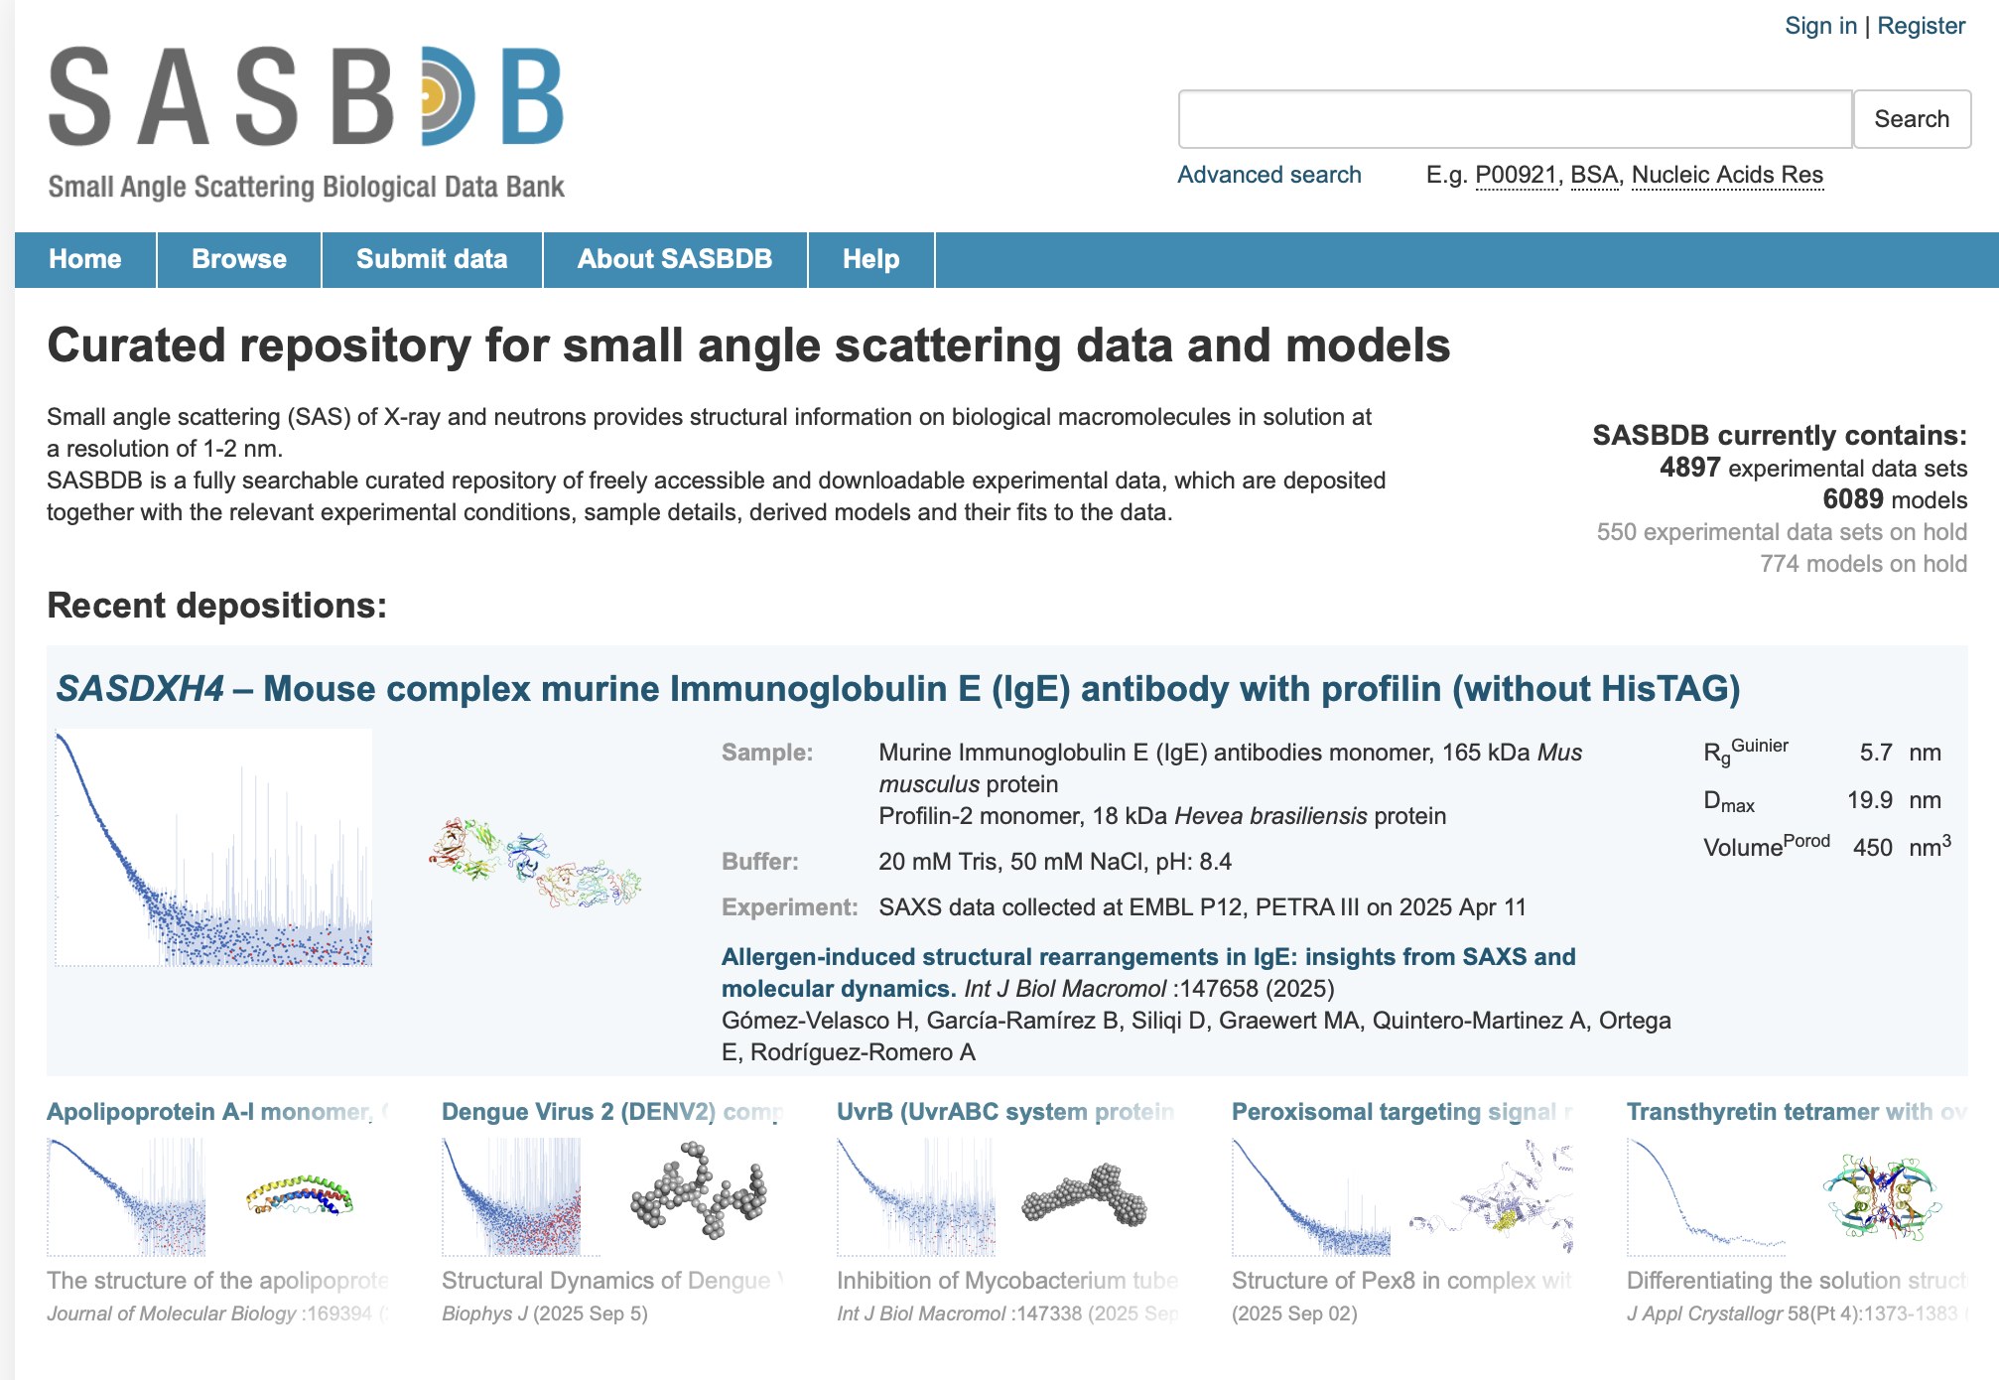
Towards SASBDB - SasView integration
Main objectives:
Provide instructions/tutorials for uploading SasView data
Use Shape2SAS to generate dummy models
Deploy SasView on HAOSC
Upload and download from GUI (optional)
Developments in SASBDB (optional)
https://www.sasbdb.org
In collaboration with Andreas (KU), Timur and Clement (EMBL Hamburg)

Slide 16
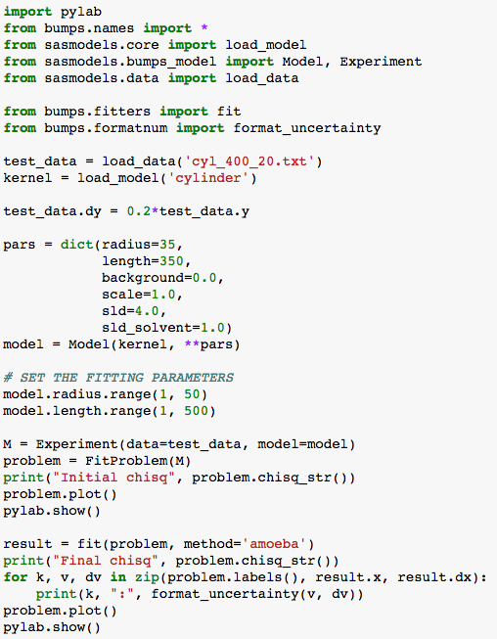
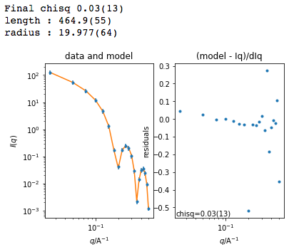
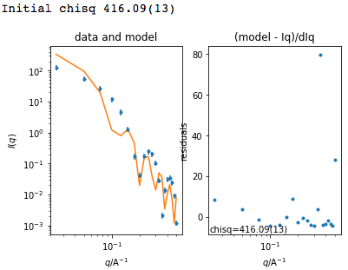
Beyond Graphical User Interface (GUI)
Useful for batch jobs and reproducibility
Scripts can be run on computer cluster
Before fit
After fit

Slide 17

What are we missing?

Slide 18
What’s next?
Write down the issues/tasks
Help defining the scope, priorities and timeline
At the next meeting:
We will review stories
Prioritize and select a few that can go to the contributor camp and more long-term

Slide 19

Just to be clear
but don’t have the resources to do the whole work…

